Slide 1
Beyond the ETL: Lambda and Kappa
Murzabekov Almaz
Moscow, 2020

Slide 2
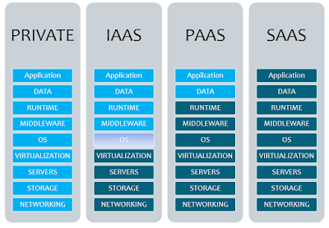
Cloud service models
and many many others

Slide 3
Architecture as a Service (AaaS)
Integration Platform as a Service (iPaaS)
Enterprise Architecture as a Service (EAaaS)
Data Architecture as a Service (DAaaS)
Data Management as a Service (DMaaS)
http://itarchitects.ca/architecture-as-a-service-aaas/
https://blog.opengroup.org/2018/07/10/enterprise-architecture-as-a-service-what/
https://www.druva.com/blog/data-management-service-understanding-technology/

Slide 4
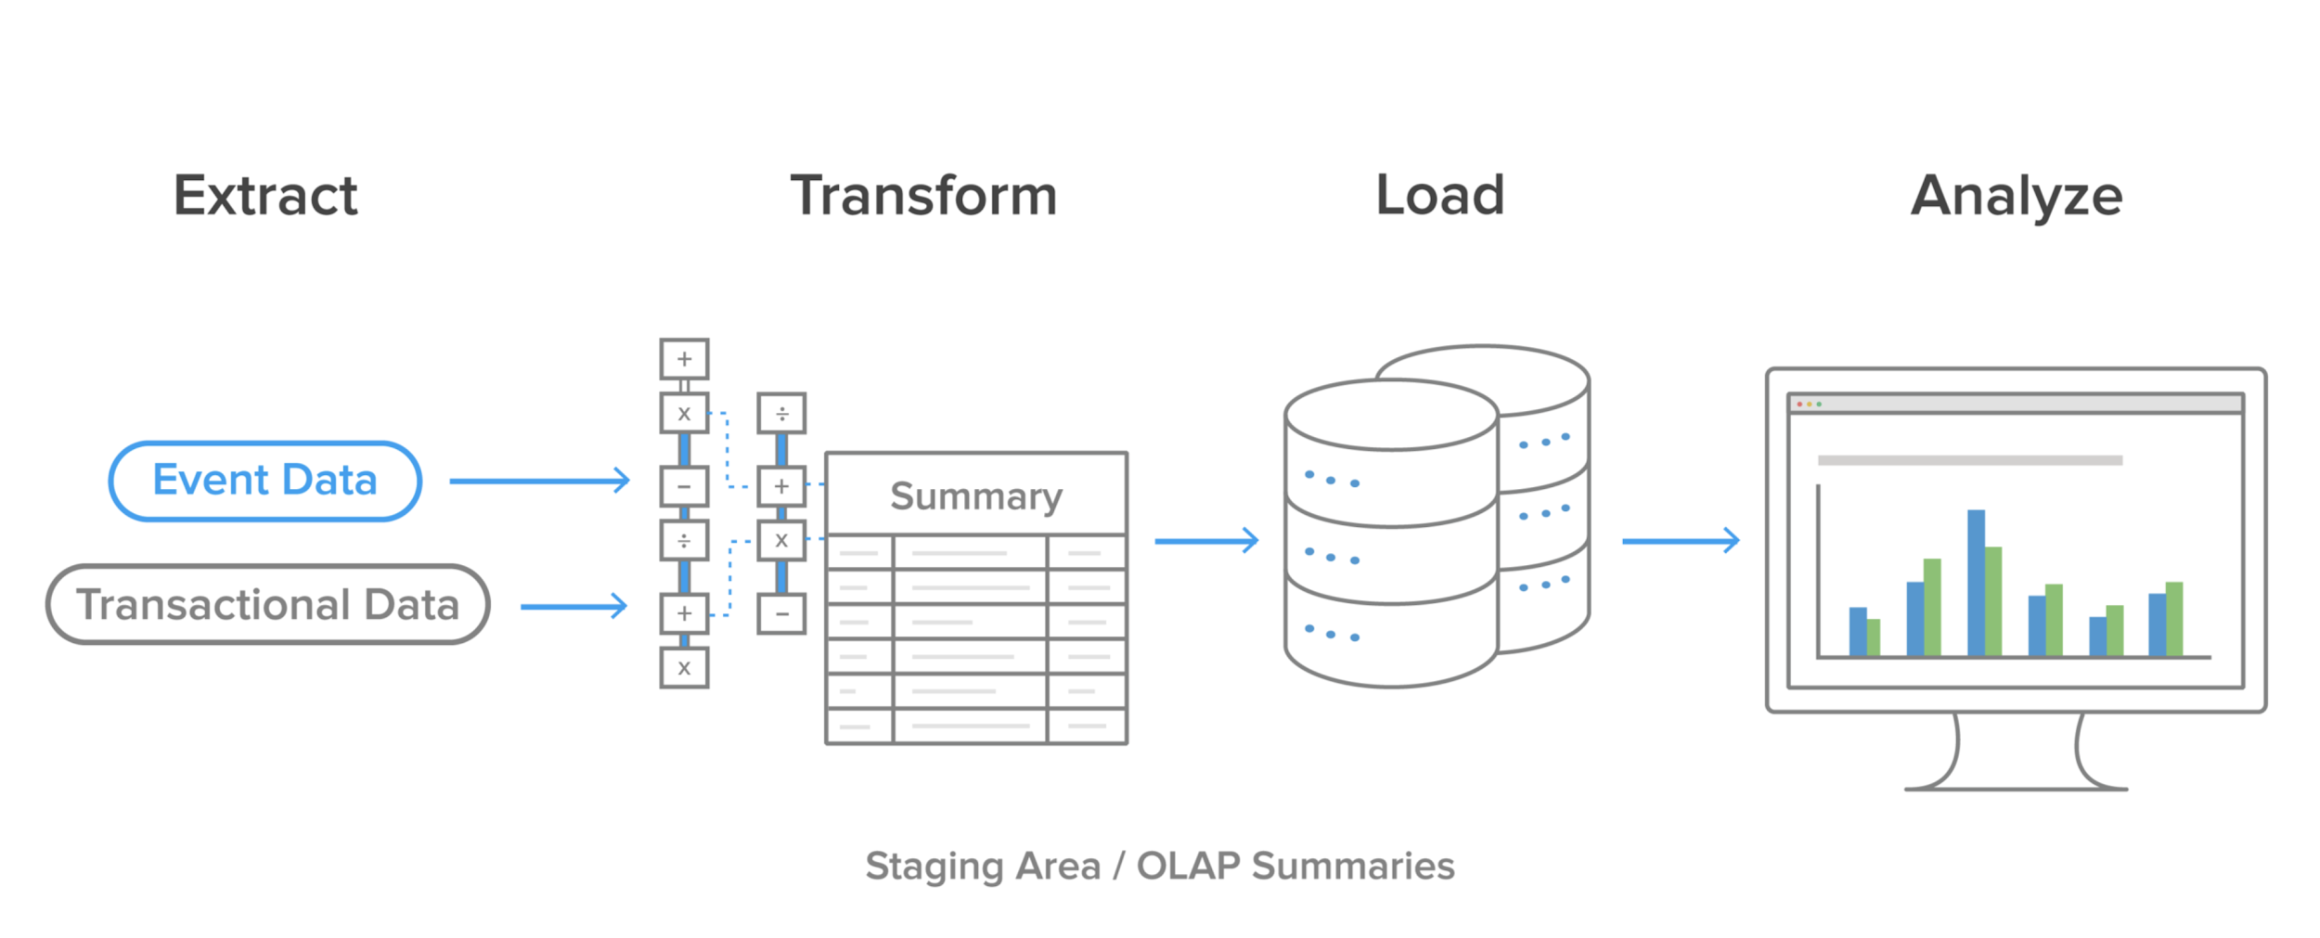
ETL-processes

Slide 5




The problems of ETL/ELT processes
MAINTENANCE COSTS
  spendings for additional staging area
  network, disks, io, etc usages
NOT A (NEAR) REAL-TIME SOLUTION
  Transformation time
STRICT DATA STRUCTURE
IMPACT FOR SOURCE SYSTEMS

Slide 6
Cloud based ETL solutions
Fivetran: https://fivetran.com/
Blendo: https://www.blendo.co/
StitchData: https://www.stitchdata.com/
Matillion: https://www.matillion.com/
SnapLogic: https://www.snaplogic.com/
ETL Tools: Comparing the Best Cloud-Based and Open Source Tools: https://panoply.io/data-warehouse-guide/etl-tools/

Slide 7
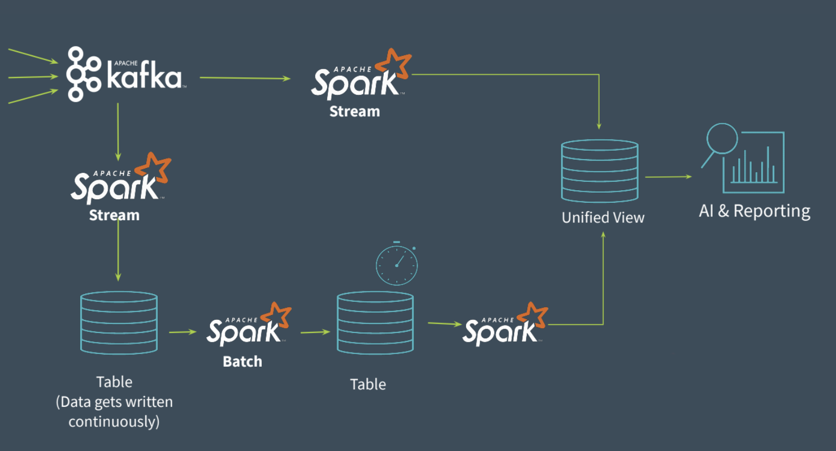
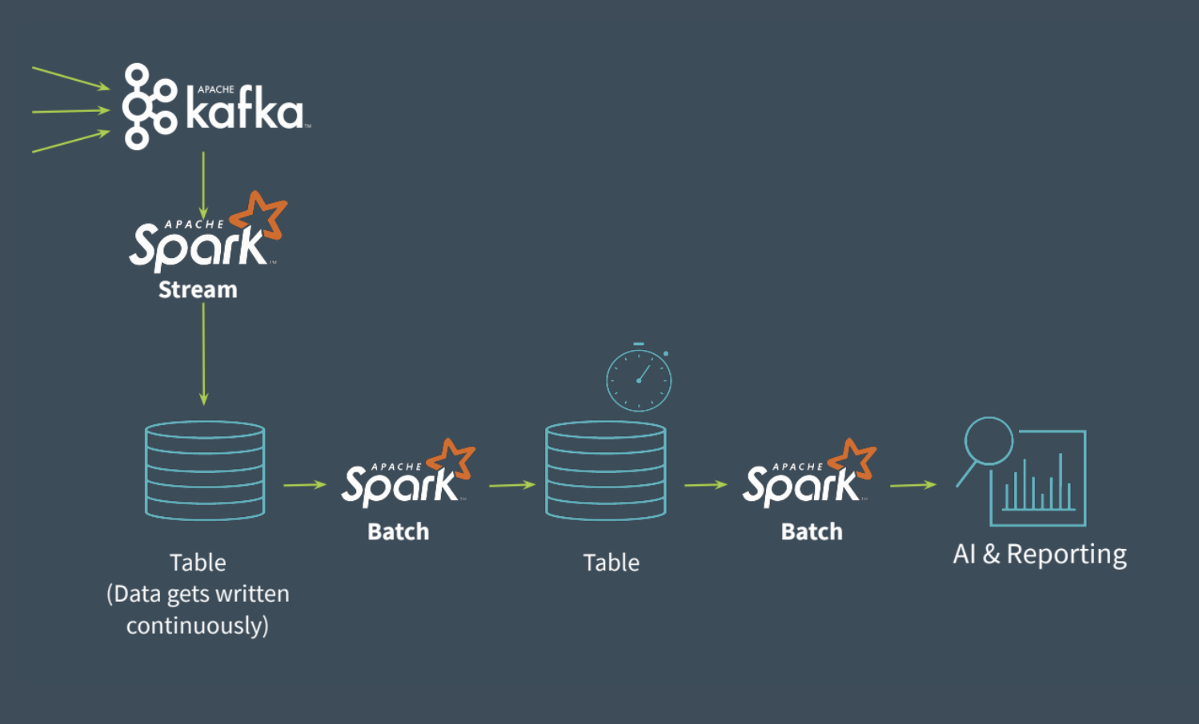
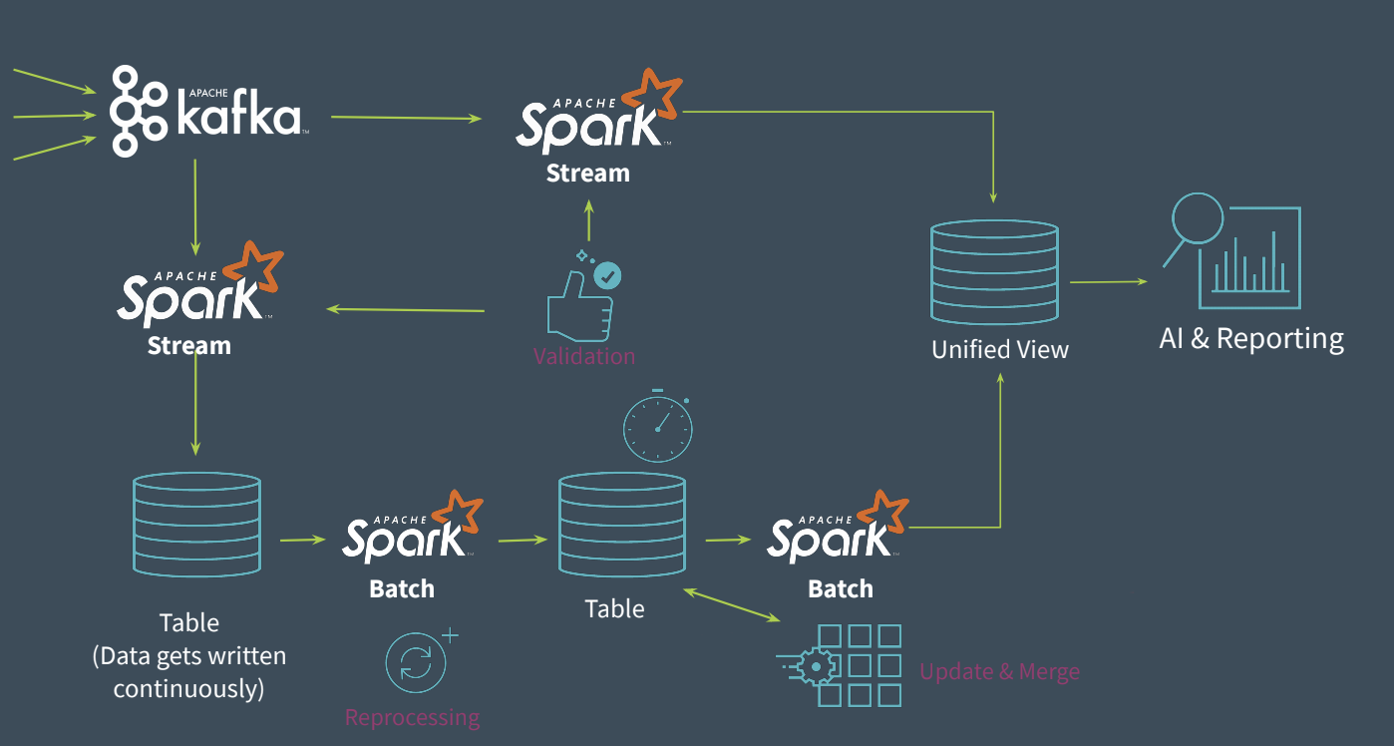
Lambda architecture

Slide 8



The problems of Lambda Architecture
CODING OVERHEAD
  Batch Layer
  Speed Layer
  Serving Layer
  Other Layers.. :-(
REPROCESSING HISTORICAL DATA
IT IS DIFFICULT

Slide 9

Kappa architecture
Keep It Simple and Stupid (KISS) - a software engineering principle

Slide 10
RESOURCES
Beyond Lambda: Introducing Delta Architecture: https://shorturl.at/iqRY1
ETL Process and The Challenges: https://softtechgroup.us/blog/etl-process-and-the-challenges
A brief introduction to two data processing architectures — Lambda and Kappa for Big Data: https://towardsdatascience.com/a-brief-introduction-to-two-data-processing-architectures-lambda-and-kappa-for-big-data-4f35c28005bb
Kappa Architecture Our Experience at ASP GEMS http://www.datascienceassn.org/sites/default/files/Kappa%20Architecture%20-%20Pros%20and%20Cons.pdf
Questioning the Lambda Architecture: https://www.oreilly.com/radar/questioning-the-lambda-architecture/
Kappa Architecture : In Practice: https://medium.com/@anishekagarwal/kappa-architecture-in-practice-b0a4870f3da6
From Lambda to Kappa: A Guide on Real-time Big Data Architectures: https://medium.com/@Talend/from-lambda-to-kappa-a-guide-on-real-time-big-data-architectures-fe63f3079d3e

